Slide 1

Department of CSE
Course: AI & ML
Course code: 24AD2001A
Topic:
Gaussian Processes (regression/classification), calibration and confidence.
Session – 28

Slide 2



AIM OF THE SESSION
The aim of this session is to introduce learners to Gaussian Processes as a probabilistic, non-parametric modeling approach for regression and classification, with emphasis on understanding kernels, uncertainty quantification, model calibration, and confidence estimation for reliable decision-making in machine learning applications.
INSTRUCTIONAL OBJECTIVES
This session is designed to:
1. Explain the need for handling missing values and describe various imputation techniques such as measures of central tendency (mean, median, mode) and KNN imputation.
2. Illustrate the importance of scaling and demonstrate methods like standardization, normalization, and robust scaling.
3. Differentiate between various encoding techniques, including one-hot encoding, label encoding, and advanced embeddings for text and images.
LEARNING OUTCOMES
At the end of this session, you should be able to:
1. Identify different types of variables (categorical, ordinal, numerical) and select suitable preprocessing techniques.
2. Apply imputation methods such as mean/median/mode replacement and KNN imputation to handle missing values in datasets.

Slide 3
Objectives
To introduce the importance of data preprocessing in improving the quality and usability of datasets.
2. To understand different imputation techniques for handling missing values effectively.
3. To explore various data scaling methods and their significance in machine learning algorithms.

Slide 4
Gaussian Processes
A potent machine learning approach that may be used for both regression and classification problems is Gaussian process classification or GPC. It is predicated on the notion of using a probabilistic model that depicts a distribution across functions, known as a Gaussian process. Using this distribution, one may forecast a function's output given a collection of input data.
GPC may be used in the classification context to forecast a new data point's class label based on its attributes. This is accomplished by modelling the likelihood of each class label for the data point using the Gaussian process. Next, it is predicted that the class label with the greatest probability is the actual class label.

Slide 5
Gaussian Process Classification
A Gaussian Process Extension for Classification Problems is called GPC. To enable a probabilistic approach to class label prediction in classification tasks, GPC models the probability distribution over possible functions. Using GPC is helpful when dealing with issues involving imbalanced datasets or complex decision boundaries. Not only does it offer forecasts, but it also measures the degree of uncertainty surrounding them. Understanding the confidence or reliability of the model's output is particularly important in applications. GPC is a flexible tool in machine learning classification tasks because it can apply past knowledge and adjust to various kinds of data.
A Gaussian process (GP) is a kind of stochastic process that has a multivariate normal distribution for each finite collection of its random variables. This indicates that the random variables have a normal distribution for every linear combination of them. Applications for GPs are many and include statistics, machine learning, and Bayesian inference.

Slide 6
CONTD..
Mean function: The anticipated value of the GP at any given input is represented by the mean function.
Covariance function: This function calculates how similar two inputs are to one another. It establishes the degree to which the GP at one input is dependent upon the GP at another.
Hyperparameters: The covariance function's shape is controlled by these parameters. Usually, a method known as marginal likelihood maximization is used to adjust them.
Marginal likelihood: A GP model's fit to a particular set of data is measured by the marginal likelihood. It is used to determine the optimal hyperparameters and assess the performance of various models.

Slide 7
Concepts of Gaussian Process Classification
Kernel functions: A kernel function, often referred to as a covariance function, is an essential element that establishes the form of the GP's prior and posterior distributions in the setting of Gaussian processes (GPs). It is vital for capturing the underlying correlations between input characteristics and goal values since it basically assesses how similar two data points are to each other.
Posterior Distribution: Our updated belief about the underlying function following data observation is represented by the posterior distribution in the Gaussian Process (GP). With the combination of the likelihood of observed data and the prior, which represents initial beliefs, a probability distribution over functions is produced. By offering a more accurate estimate of the true underlying function based on the evidence at hand, the posterior captures the process of reducing uncertainty. Through the incorporation of observed data into the modeling process, it facilitates well-informed decision making.

Slide 8
CONTD..
Prior Distribution: The prior distribution in Gaussian Process (GP) describes our presumptions about the underlying function before any data are observed. It defines the potential functions that might be used to characterize the underlying process, acting as a versatile and expressive model. Prior to taking into account actual data, our expectations and presumptions were reflected in the prior selection. Because of its rich prior, the GP is an effective tool for modeling complex and uncertain systems in statistics and machine learning. It can capture a wide range of function behaviors.

Slide 9
Gaussian Process Regression (GPR)
Regression and probabilistic classification issues can be resolved using the Gaussian process (GP), a supervised learning technique. Since each Gaussian process can be thought of as an infinite-dimensional generalization of multivariate Gaussian distributions, the term "Gaussian" appears in the name. We will discuss Gaussian processes for regression in this post, which is also referred to as Gaussian process regression (GPR). Numerous real-world issues in the fields of materials science, chemistry, physics, and biology have been resolved with the use of GPR.

Slide 10
Gaussian Process Regression (GPR)
Gaussian Process Regression (GPR) is a powerful and flexible non-parametric regression technique used in machine learning and statistics. It is particularly useful when dealing with problems involving continuous data, where the relationship between input variables and output is not explicitly known or can be complex. GPR is a Bayesian approach that can model certainty in predictions, making it a valuable tool for various applications, including optimization, time series forecasting, and more. GPR is based on the concept of a Gaussian process, which is a collection of random variables, any finite number of which have a joint Gaussian distribution. A Gaussian process can be thought of as a distribution of functions.
Key Concepts of Gaussian Process Regression (GPR)
Gaussain Process
A non-parametric, probabilistic model called a Gaussian Process (GP) is utilized in statistics and machine learning for regression, classification, and uncertainty quantification. It depicts a group of random variables, each of which has a joint Gaussian distribution and can have a finite number. GPs are a versatile and effective technique for modeling intricate relationships in data and producing forecasts with related uncertainty.

Slide 11
Characteristics of Gaussian Processes:
Non-Parametric Nature: GPs can adjust to the complexity of the data because they do not rely on a set number of model parameters
Probabilistic Predictions: Predictions from GPs can be quantified because they deliver predictions as probability distributions.
Interpolation and Smoothing: GPs are useful for noisy or irregularly sampled data because they are good at smoothing noisy data and interpolating between data points.
Marginalization of Hyperparameters: By eliminating the requirement for explicit hyperparameter tweaking, they marginalize over hyperparameters, making the model simpler.

Slide 12
CONTD..
Mean Function: The predicted value of the function being modeled at each input point is represented by the mean function in Gaussian Processes (GPs). It functions as a foundational presumption regarding the underlying data structure. The mean function is frequently set to zero by default not necessarily and can be modified based on data properties or domain expertise. By influencing the central tendency of forecasts, it aids general practitioners in identifying patterns or trends in the data. GPs provide probabilistic predictions that contain uncertainty as well as point estimates by including the mean function.
Covariance (Kernel) Function
The covariance function, also referred to as the kernel function, measures how similar the input data points are to one another in Gaussian Processes (GPs). It is essential in characterizing the behavior of the GP model, affecting the selection of functions from the previous distribution. The covariance function measures pairwise similarities to ascertain the correlation between function values. GPs can adjust to a broad range of data patterns, from smooth trends to complex structures, because different kernel functions capture different kinds of correlations. The model's performance can be greatly impacted by the kernel selection.

Slide 13
CONTD…
Prior Distributions
The prior distribution, in Gaussian Processes (GPs), is our understanding of functions prior to the observation of any data. Usually, it is described by a covariance (kernel) function and a mean function. Whereas the covariance function describes the similarity or correlation between function values at various input points, the mean function encodes our previous expectations. This is used beforehand by GPs to create a distribution over functions. In GPs, priors can be selected to represent data uncertainty, integrate domain knowledge, or indicate smoothness.
Posterior Distributions
Gaussian Processes' posterior distribution shows our revised assumptions about functions following data observation. It puts together the likelihood of the data given the function and the previous distribution. The posterior in GP regression offers a distribution over functions that most closely match the observed data. By allowing for probabilistic predictions and the quantification of uncertainty, the posterior distribution reflects the trade-off between the prior beliefs stored in the prior distribution and the information supplied by the data.
.

Slide 14
Mathematical Concept of Gaussian Process Regression (GPR)
For regression tasks, a non-parametric, probabilistic machine learning model called Gaussian Process (GP) regression is employed. When modeling intricate and ambiguous interactions between input and output variables, it's a potent tool. A multivariate Gaussian distribution is assumed to produce the data points in GP regression, and the objective is to infer this distribution.
The GP regression model has the following mathematical expression. Let's assume x₁ , x₂ ,.....,x_{n} are the input data points , where x belong to real numbers(-2,-1,0,1...), (x_{i} ϵϵ R)
Let's assume y₁ , y_{2 ,}......., y_{n} are the output values, where y_{i} belongs to real number (y_{i} ϵϵ R)
The GP regression model makes the assumption that a Gaussian process with a mean function (μμ) and covariance function (k) provides the function f that connects the inputs to the outputs.

Slide 15
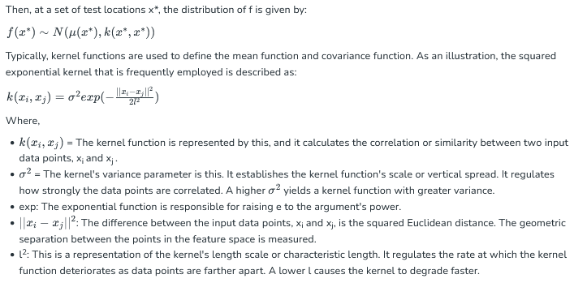
CONTD..

Slide 16
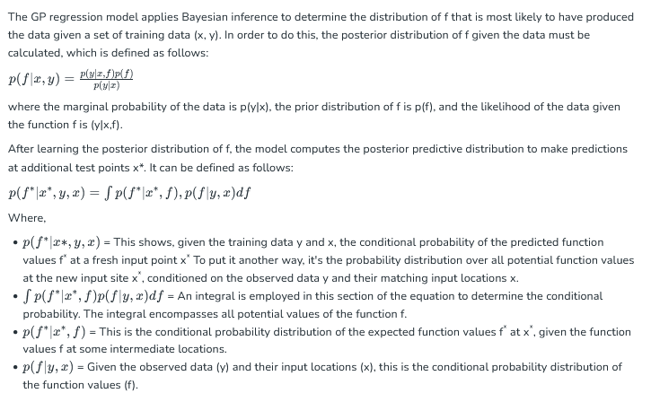
CONTD..

Slide 17
calibration and confidence.
Calibration and confidence refer to a model's ability to accurately represent the true likelihood of its predictions being correct. A well-calibrated model's confidence scores align with its actual performance, meaning a 70% confidence score implies a 70% accuracy rate over many predictions. This is crucial in high-stakes applications, such as medical diagnosis or self-driving cars, because it allows users to trust the model's output and identify potentially problematic predictions that should be reviewed or discarded, ultimately improving safety and reliability.
What is Calibration?
Matching Probability to Reality: Calibration ensures that the probability a model assigns to a prediction accurately reflects the real-world chance of that prediction being correct.

Slide 18
CONTD…
Trust in Confidence: For a model to be calibrated, its confidence scores should have a real-world meaning based on actual data, not just training data. Example: If a neural network predicts an image is a cat with 80% confidence, a well-calibrated model would be correct about 80% of the time for similar predictions.
Why is Calibration Important?
Safety and Reliability: In critical systems like autonomous vehicles or healthcare, accurate confidence scores are vital for avoiding severe errors.
Identifying Weak Predictions: Calibration allows for the detection and handling of low-quality predictions by associating them with low confidence levels

Slide 19
CONTD..
User Trust: Trusted predictions require well-calibrated confidence scores, which build user trust in the model's output.
How Does It Work in Practice?
Monitoring Uncertainty: A drop in confidence from a well-calibrated model can act as a signal to trigger safety mechanisms or prompt human review, such as in a self-driving car recognizing a stop sign.
Data-Driven Evaluation: Evaluating calibration involves assessing how much confidence scores can be trusted in relation to the model's actual accuracy on real-world data. Beyond Training Data: This process moves beyond just the training or validation data to ensure the model's confidence is reliable in practical, deployed scenarios.

Slide 20
Self-Assessment Questions
1. A Gaussian Process (GP) is best described as:
A distribution over random variables
A distribution over functions
A linear regression model
A neural network
Which two components define a Gaussian Process?
Mean function and covariance function
Loss function and optimizer
Kernel and gradient
Activation and bias

Slide 21
TERMINAL QUESTIONS
What is a Gaussian Process (GP) in machine learning?
2. How is Gaussian Process Regression (GPR) different from Linear Regression?
3. What role does the kernel function play in Gaussian Processes?

Slide 22
REFERENCES FOR FURTHER LEARNING OF THE SESSION
Books:
1. Gaussian Processes for Machine Learning – Carl Edward Rasmussen & Christopher K. I. Williams (MIT Press, 2006)
The classic reference book on GPs, covering regression, classification, kernels, inference, and approximations.
2. Machine Learning: A Probabilistic Perspective – Kevin P. Murphy (MIT Press, 2012)
Explains probabilistic modeling in depth, including Gaussian Processes and Bayesian inference.
Web references:
Gaussian Processes for Machine Learning (Book PDF by Rasmussen & Williams)
http://www.gaussianprocess.org/gpml/
Machine Learning Mastery – Gentle Introduction to Gaussian Processes
https://machinelearningmastery.com/gaussian-processes-for-machine-learning/

Slide 23
THANK YOU
Team – AI &ML

